Slide 1
Time zone &Greenwich,england
Terry , Christofer, Kerry and DaZane’.

Slide 2
There are 25 integers in the world time zones from -12 through ( GMT) to +12. Each one is 15 degrees of longitude as measured east and west from Prime Meridian of the world at Greenwich, England.
Some countries have adopted non-standard time zones.
Each time zone is measured relative to Greenwich ,England.

Slide 3
Located at 0 degrees longitude.
There are seven time zones: Seven time zones: Newfoundland, Atlantic, Eastern, Central, Mountain, Pacific, and Alaska.
Greenwich never observes daylight savings time.

Slide 4
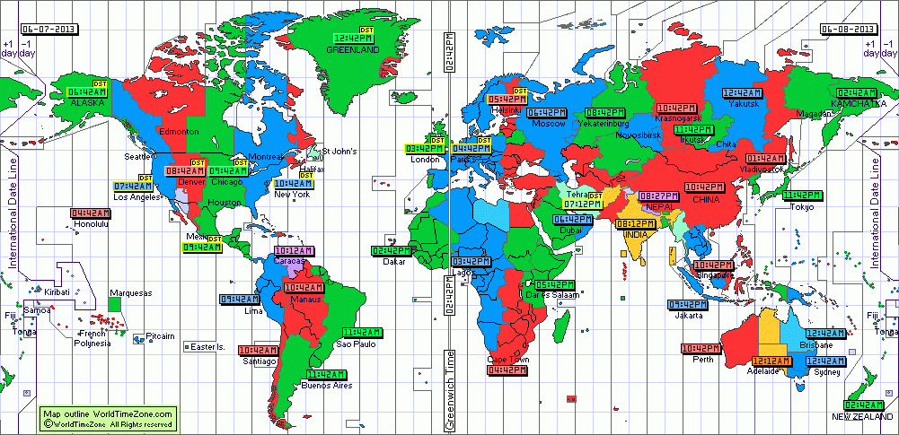
This is a map of the time zones for interactive go to this website : www.timeandate.com/time/map/

Slide 5
Funfacts
It was established in1884 at the international meridian conference.
It was decided to place the prime meridian at Greenwich, England.
Greenwich, England is on 51 degrees 28’ 38’ North latitude.
Greenwich, England is where east meets west at the Greenwich meridian ( 0degrees longitude), it is north of the equator.
It is known as zero degrees longitude ( prime meridian) and it is the line from which all other lines of longitude are measured

Slide 6
Sources
www.timeanddate.com/time/map/
www.worldatlas.com
www.worldtimezone.com

