Slide 1
Map Projections
(The Finders)
Created by: Phylicia, James, Jimmy, and Ajah

Slide 2
Table of Contents
What is a map projection
Mercator Projection
Compromise projections
Photos

Slide 3
What is a map projection
Necessary for creating maps
A way to represent the curved surface of the Earth on the flat surface of a map
Allows us to represent some or all of the Earth’s surface, at a wide variety of a scales, on a flat, easily transportable surface, such as a piece of paper.

Slide 4
Mercator Projection
The Mercator projection was created by Gerardus Mercator in 1569.
The Mercator projections exaggerates “the farther from the equator on the map, the larger the area will get.

Slide 5
Compromise
Compromise projections create perfectly pressing metric properties
Makes things look right
Distort shape in the polar regions more than at the equator
The Gnomonic projections is thought to be the oldest map projection,, developed by Thales in the 6th century BC

Slide 6
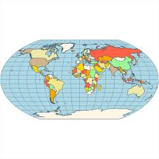
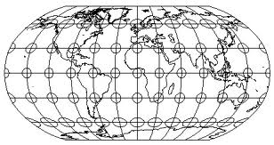
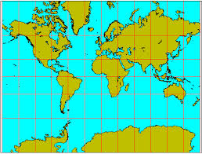
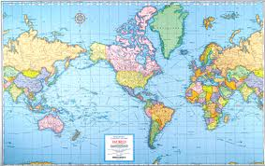
Photos
Compromise
Mercator

