Slide 1
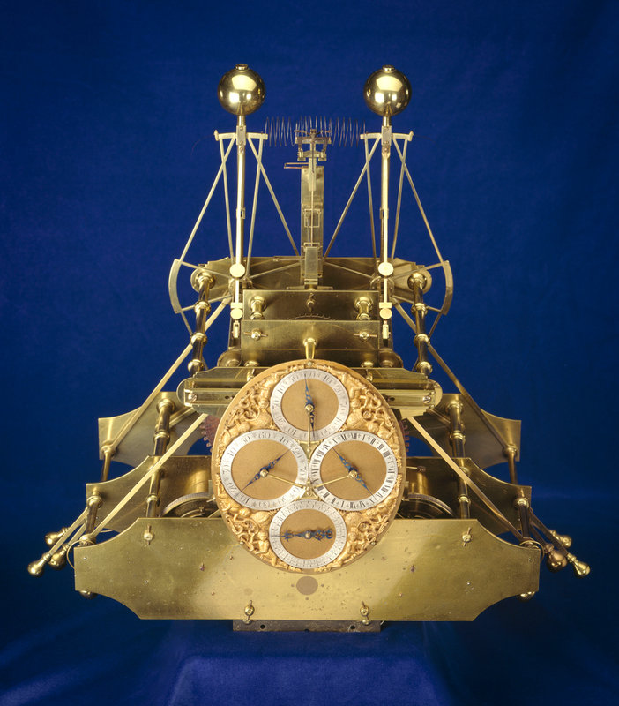
John Harrison
By: Ashley, Cavana, Helen, and Tiana

Slide 2
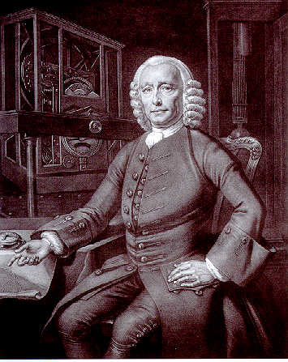
His Life
John Harrison was born on March 24th 1693 in Foulby, Yorkshire English carpenter and later a clockmaker. Harrison built his first long-case clock in 1713, at the age of 20. It was made entirely of wood. He also helped sailor's around the world by making the worlds first Sea Watch (that could tell time at sea). The watch became so population to the point where it was used by the Marines.

Slide 3
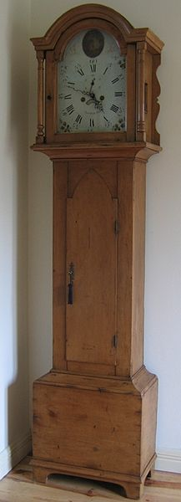
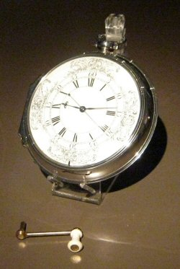
His First Creations
The first clock that John Harrison made was the long-case clock. Its is a tall, freestanding clock that is 6-8 feet tall. It was made to tell the time of day and also keep track of time.
Harrisons first Marine Watch
This Sea Watch was used to tell time in order to keep track of where the ships sailed and their current location just by recording the time they sailed out to sea.

Slide 4
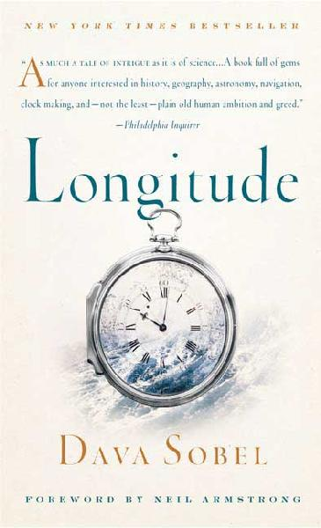
Problem Solved
Longitude is about the problem that many people have in the old days of not being able to keep track of time at sea. And how John Harrison help solve that problem by making Sea Watches.

Slide 5
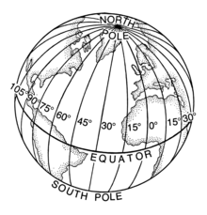
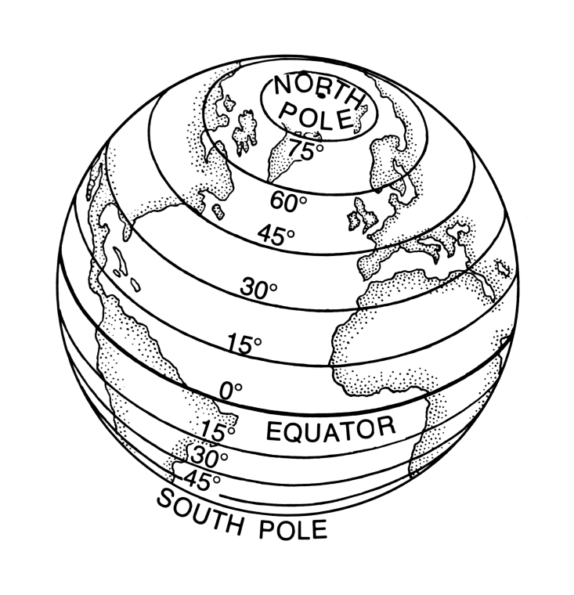
World Measurements
Longitude runs from the North Pole to the South Pole but, is measured from West to East.
Latitude runs from West to East but, is measured from North to South.

Slide 6
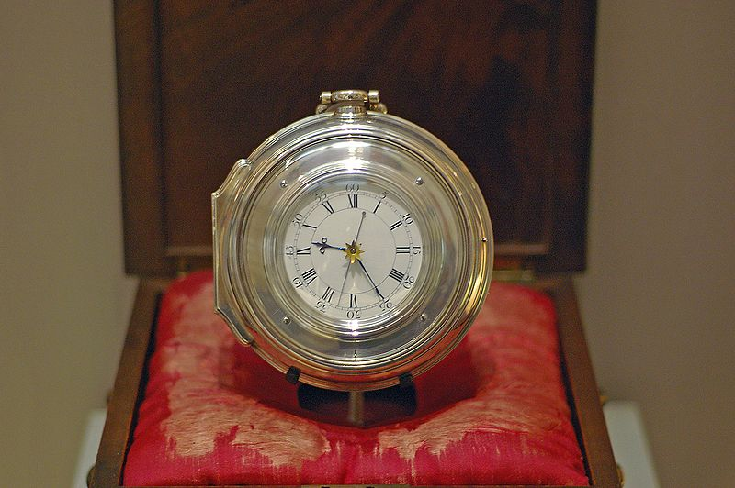
The End

